Slide 1
Computer Builder
John Ortega, Gabriel Irizarry Torres

Slide 2
Project Specifications
Computer building tool.
Users are able to view computer components along with the components msrp, as well as relevant specs for the selected components.
Once users select a configuration for their computer users are able to save share and delete their selected configuration.

Slide 3
Implementation
MySQL for the database
Subject to Change: MAMP, PHPmyAdmin, PHP

Slide 4
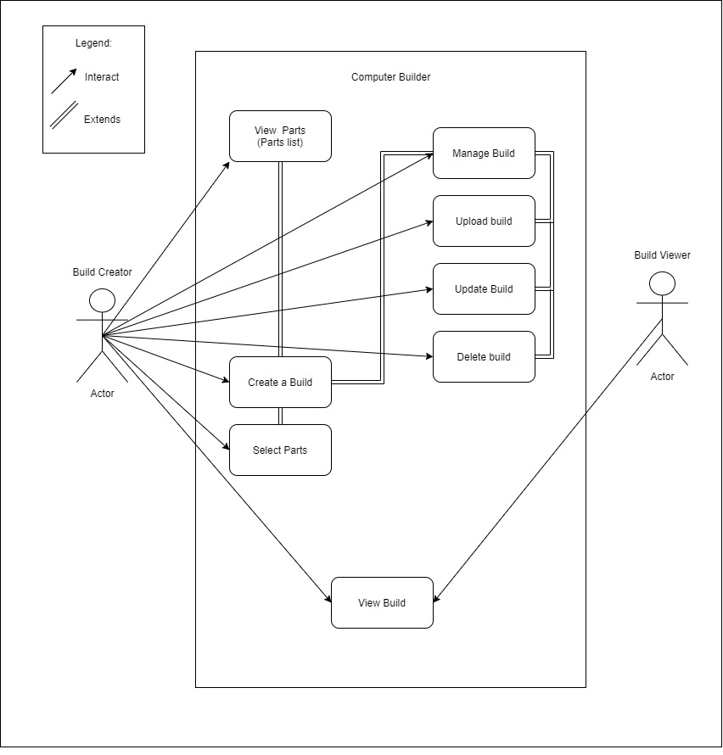
Use-Case

Slide 5
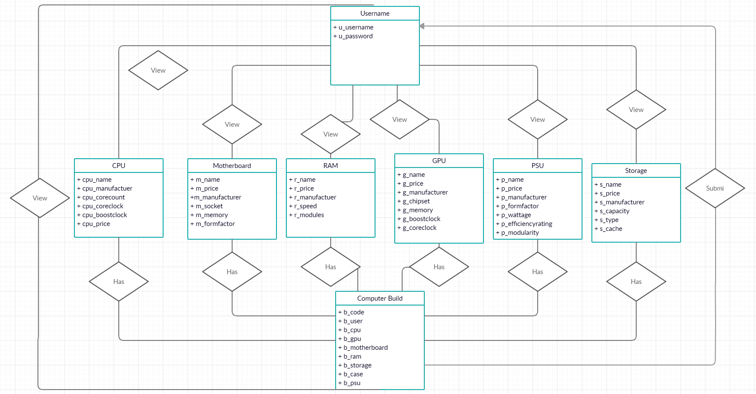
E/R Diagram

Slide 6
Relational Schema
CPU
cpu_name, cpu_price, cpu_manufacturer, cpu_corecount, cpu_coreclock, cpu_boostclock
GPU
g_name, g_price, g_manufacturer, g_chipset, g_memory, g_boostclock, g_coreclock
Motherboard
m_name, m_price, m_manufacturer, m_socket, m_formfactor
Ram
r_name, r_price, r_manufacturer, r_speed, r_modules
Storage
s_name, s_price, s_manufacturer, s_capacity, s_type, s_chache
Case
c_name, c_price, c_manufacturer, c_formfactor
PSU
p_name, p_price, p_manufacturer, p_formfactor, p_wattage, p_efficiencyrating, p_modularity
Computer Build
b_user, b_code, b_cpu, b_gpu, b_motherboard, b_ram, b_storage, b_case, b_psu
User
u_user, u_password

